Slide 1
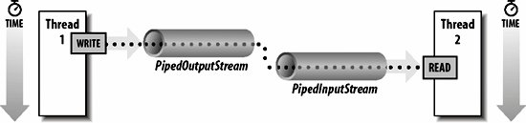
Java PipedInputStream and PipedOutputStream classes
The java.io.PipedInputStream class and java.io.PipedOutputStream classes provide a convenient means to move data from one thread to another. Output from one thread becomes input for the other thread.
The PipedInputStream and PipedOutputStream classes can be used to read and write data simultaneously. Both streams are connected with each other using the connect() method of the PipedOutputStream class.

Slide 2
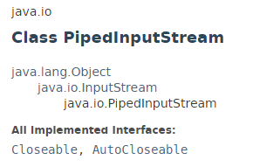
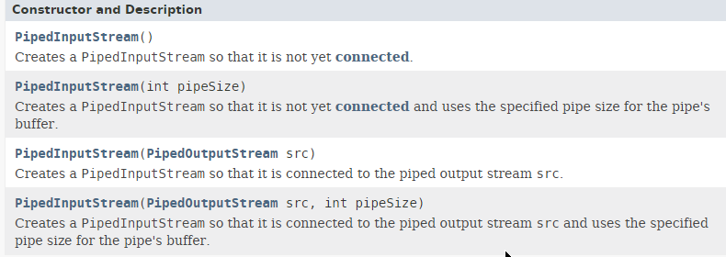
Java PipedInputStream and PipedOutputStream classes

Slide 3
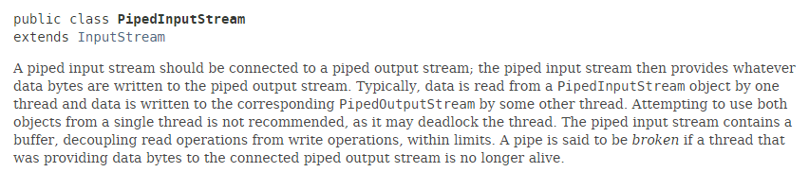
Java PipedInputStream and PipedOutputStream classes

Slide 4
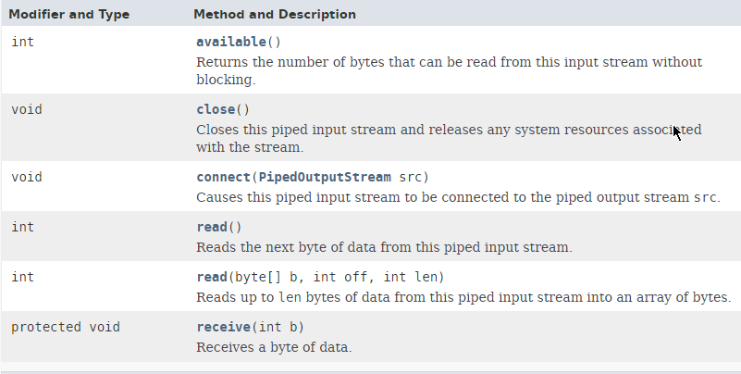
Java PipedInputStream and PipedOutputStream classes

Slide 5
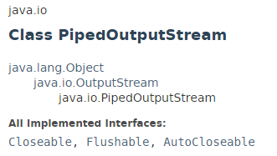
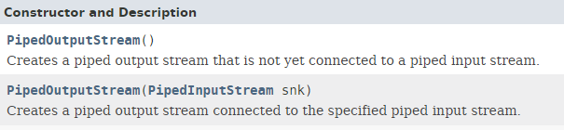
Java PipedInputStream and PipedOutputStream classes

Slide 6
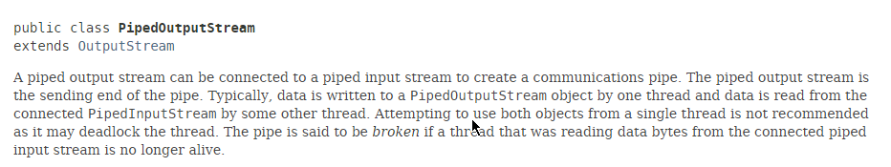
Java PipedInputStream and PipedOutputStream classes

Slide 7
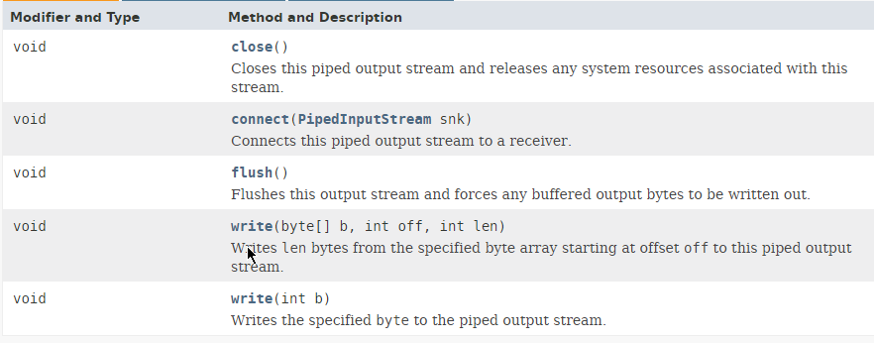
Java PipedInputStream and PipedOutputStream classes

Slide 8
Java PipedInputStream and PipedOutputStream classes
https://docs.oracle.com/javase/8/docs/api/index.html?java/io/PipedInputStream.html
https://docs.oracle.com/javase/8/docs/api/index.html?java/io/PipedOutputStream.html

